Slide 1

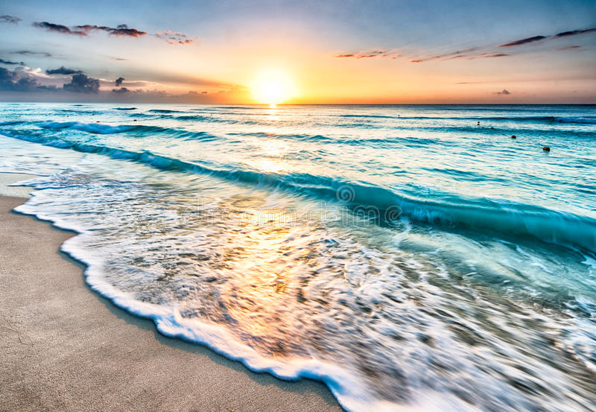
MIC Smart Beach by Bruce County
for Dr. Alex Smith
Sanjeev Kumar - Professor
Brunilda Xhaferllari – Project Manager
Rich Freeman – Faculty Mentor
AI Team:
Janvi Patel
Fangji Chen
Scaria Ouseph Kurian
Date: 02-09-2023
Notes:
Image: 12019 (2016) Ocean waves crashing on shore during daytime https://pixabay.com/photos/beach-sea-sunset-sun-sunlight-1751455/

Slide 2
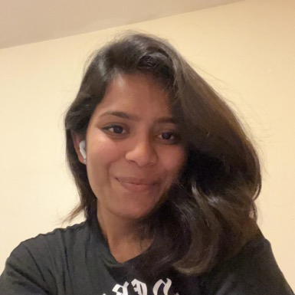
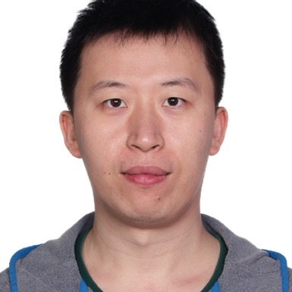
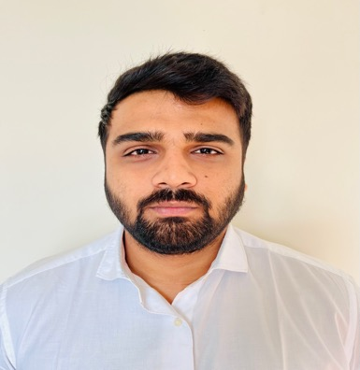

Our Team
Janvi
Patel
Scaria Ouseph Kurian
Fangji Chen
Project Lead / Communicator
Developer
Analyst

Slide 3

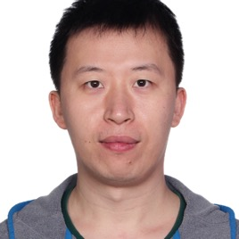
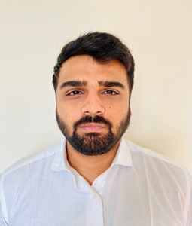
Who we are
I have a Bachelor of Computer Science degree from GTU. Prior to the Big Data Analysis program at Georgian College, I was a software developer. In terms of skills, I have high communication and organization with intermediate level experience in Python, Power BI, Machine Learning, and Deep Learning. I look forward to this project and our future weeks together.
I have a bachelor's degree in electronic information engineering and have 10 years of working experience in software engineering, data mining, and machine learning after graduating. I'm glad to work on this project and move forward with the group.
I have a Bachelor’s degree in computer science and a postgraduate program in Big Data Analytics and now I’m pursuing Artificial intelligence at Georgian college. I have an intermediate level experience in Power BI, Machine Learning, and Python. I’m glad to work on this project and move forward with this group.

Slide 4
Project Summary
The smart beach project is a three year pilot project that will provide swimmers with up-to-date information on water conditions.
The general project agenda is to use buoy(National oceanic and atmospheric administration) data and camera images to predict future water conditions.
There are 3 questions provided by MIC to the whole team of the which AI team will be working on the following question.
Predict the wave conditions and current visible in the camera images, as well the number and distribution of people on the beach and in the water.

Slide 5
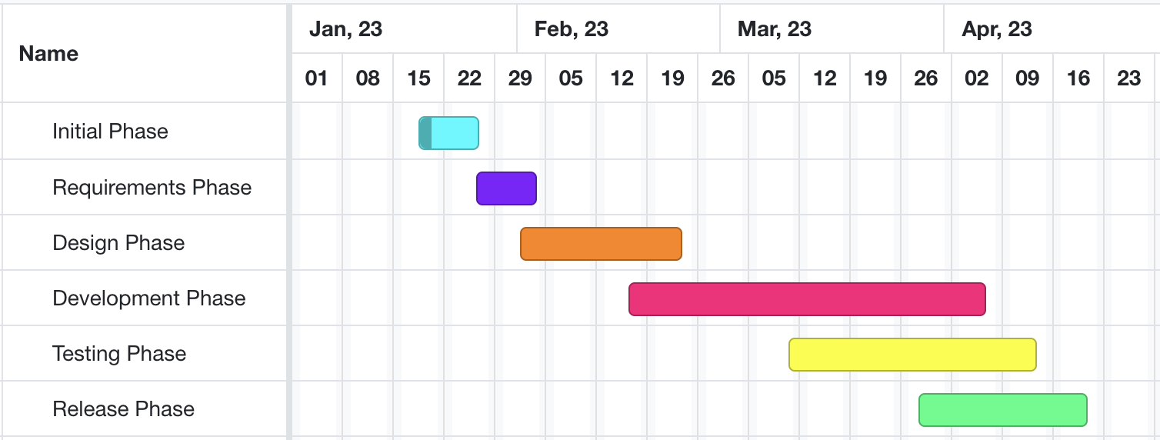
High-level GANTT Chart

Slide 6

Additional activities since last report
Work:
We were working on Image Classification.
There are few models to compare accuracy.
CSRNet
Faster R-CNN
DenseNet
Notes:
Padrinan, Miguel (n.d.). Email blocks on Gray Surface. Accessed on January 16th, 2023 from https://www.pexels.com/photo/email-blocks-on-gray-surface-1591062/

Slide 7
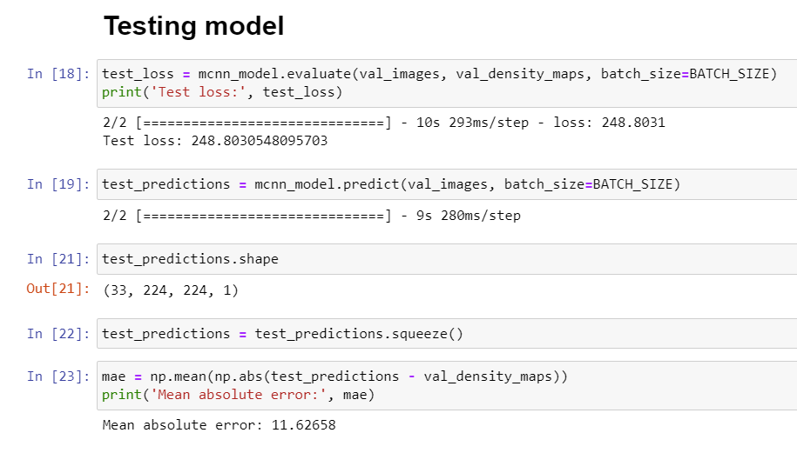
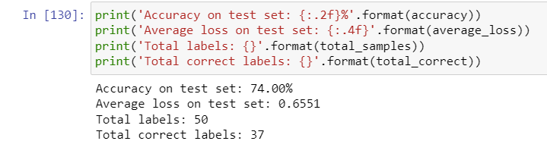
Model Comparision
CSRNet
DenseNet

Slide 8
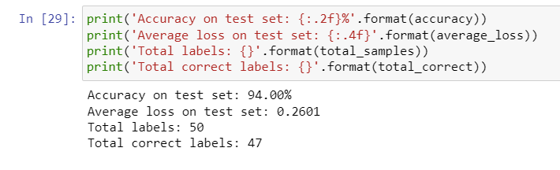
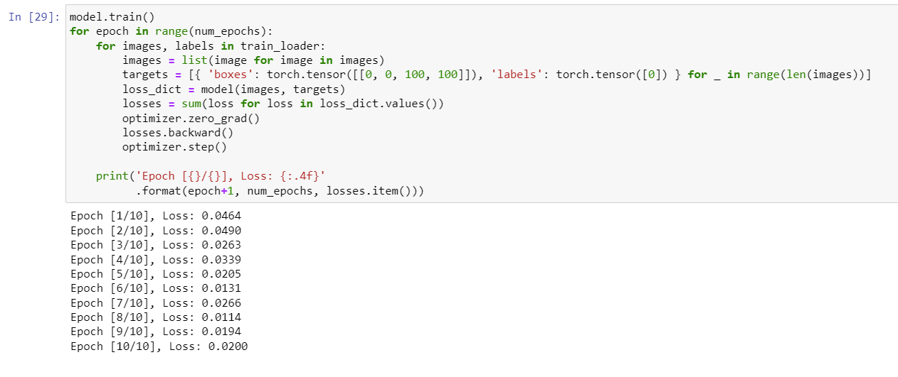
Model Comparision
DenseNet with 50 epoch
Faster RCNN

Slide 9
Image classification
Main purpose of Image classification is for crowd density and camera angle.
Some of the models that work best for crowd density are:
CSRNet.
DenseNet.
R-CNN.
All these algorithms work in different situations same as for crowd counting.
CSRNet is the short form of Convolution Neural network that uses feature extraction for crowd density classification.
DenseNet is specialized for image classification tasks.
R-CNN Region-Based Convolution Neural Network, the major benefit of which can be classified based on region segmentation.
All these models are trained on the dataset for this specific project to classify the images.
The classification, for now, is done in 3 classes.
One, in which people can be identified clearly.
Second, in which the images are not too crowded or the camera distance is not so far.
Third, in which images are more crowded and the distance is far (forming a cluster).

Slide 10
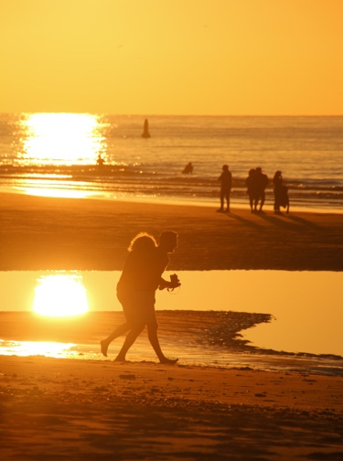
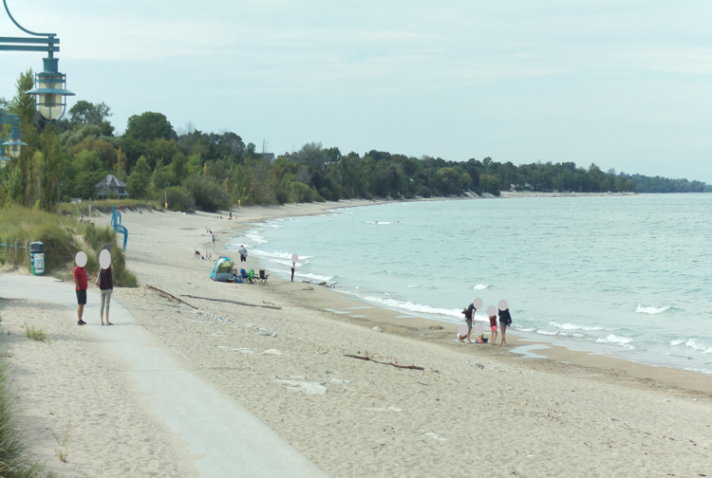
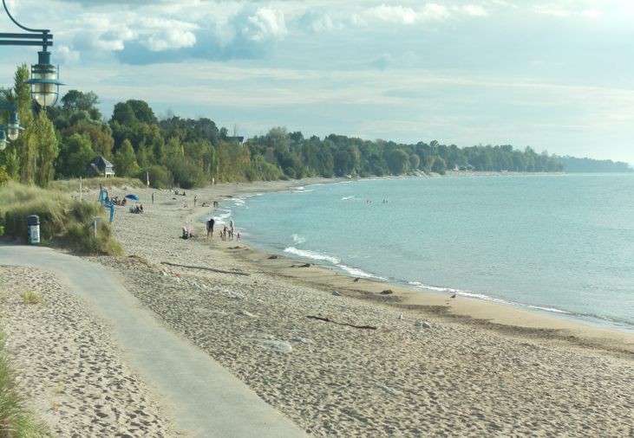
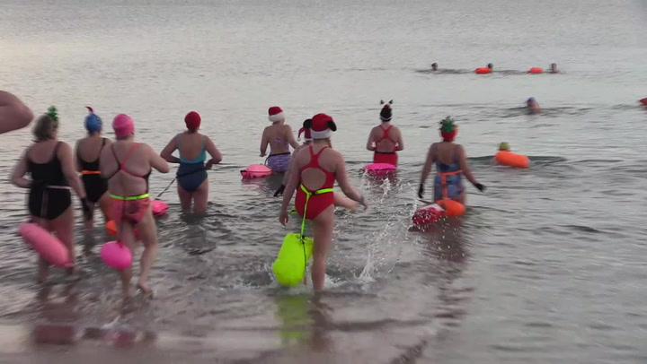
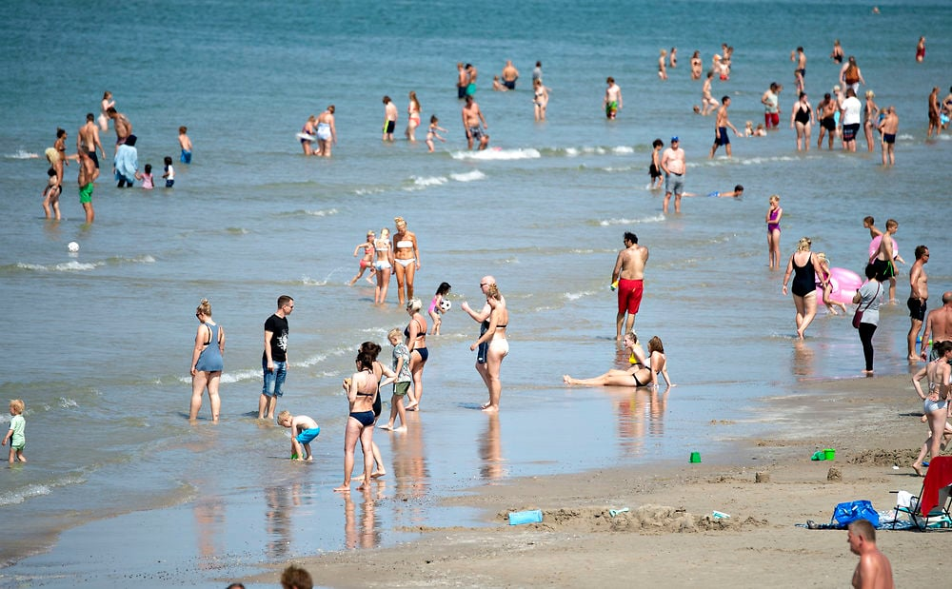
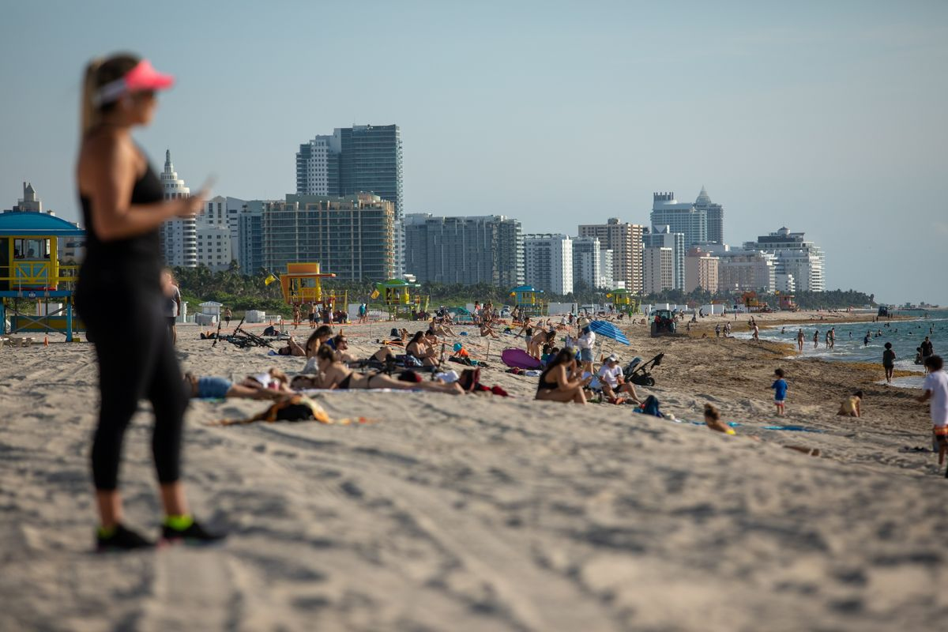
Image Classification -- results
Class : 0​
Class : 1
Class : 2

Slide 11
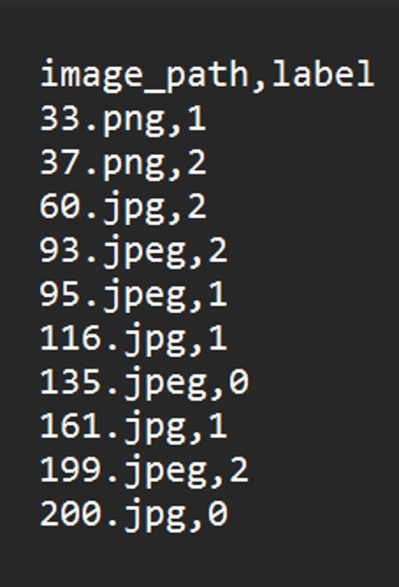
Image Classification -- result
As we can see here the model provides a CSV file including the predicted labels and image file name.

Slide 12
ComplexitY
CSRNet:
The CSRNet model has an average loss of around 248. Making the accuracy way lower.
DenseNet:
The DenseNet model with 10 epochs gave an accuracy of about 74%. After increasing the epoch count to 50 the accuracy increased drastically to 94%.
Faster R-CNN:
The RCNN model has the lowest average loss, even less than 0.05. Which will give the best output for classification. Also, RCNN will allow us to classify on the bases of the region as well.

Slide 13
Latest architecture of our project

Slide 14
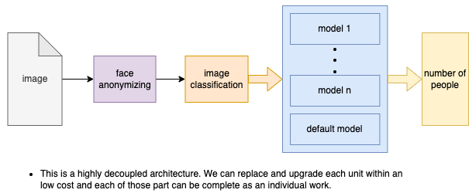
Pipeline of deployment

Slide 15
Standard developing pipeline
Ground truth dataset
Raw image
Image annotation
Metrics calculation
Model validating results
batch
outcome

Slide 16
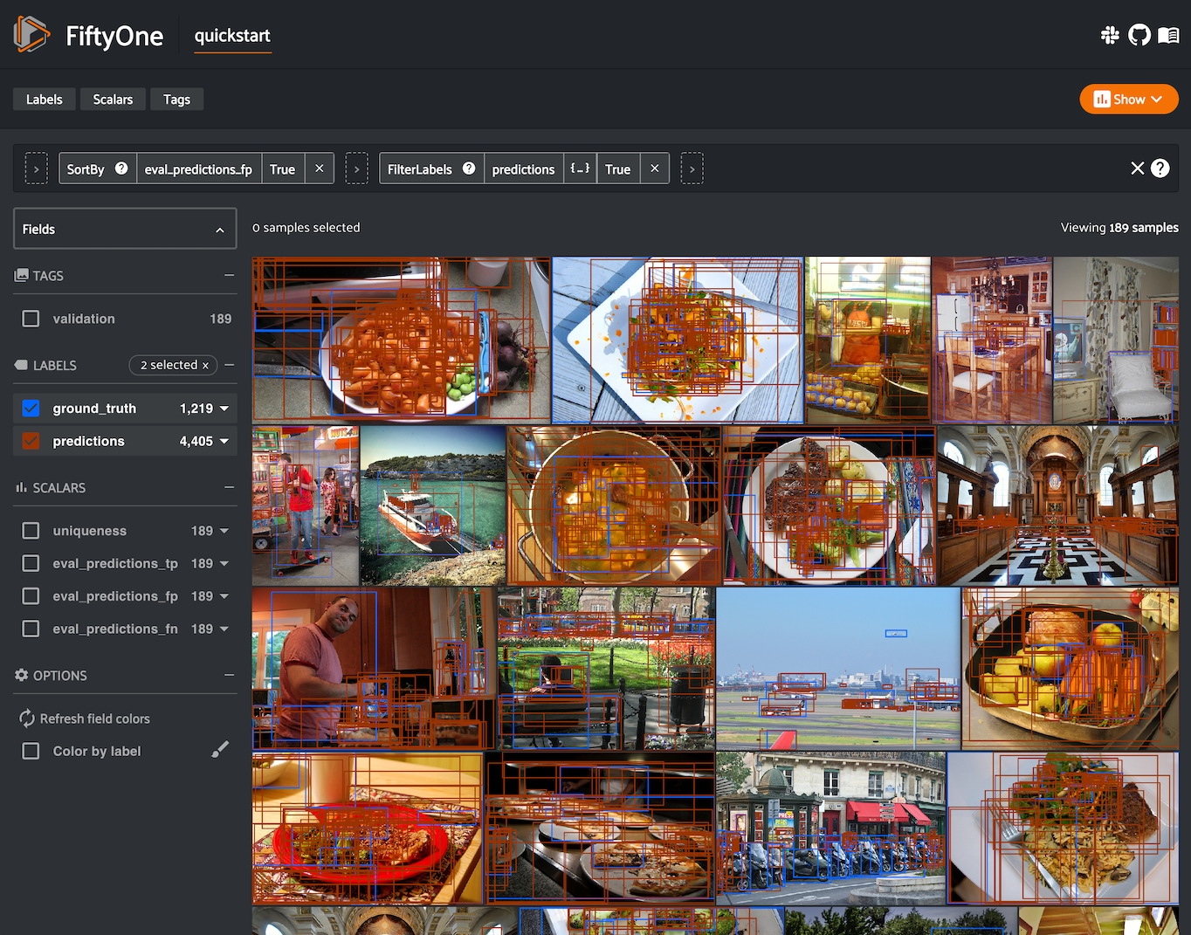
Individual Status Report – Fangi
Model performance metrics under the form of COCO Annotations
Working on COCO annotation standards to evaluate model performance on Bruce Beach camera images.

Slide 17
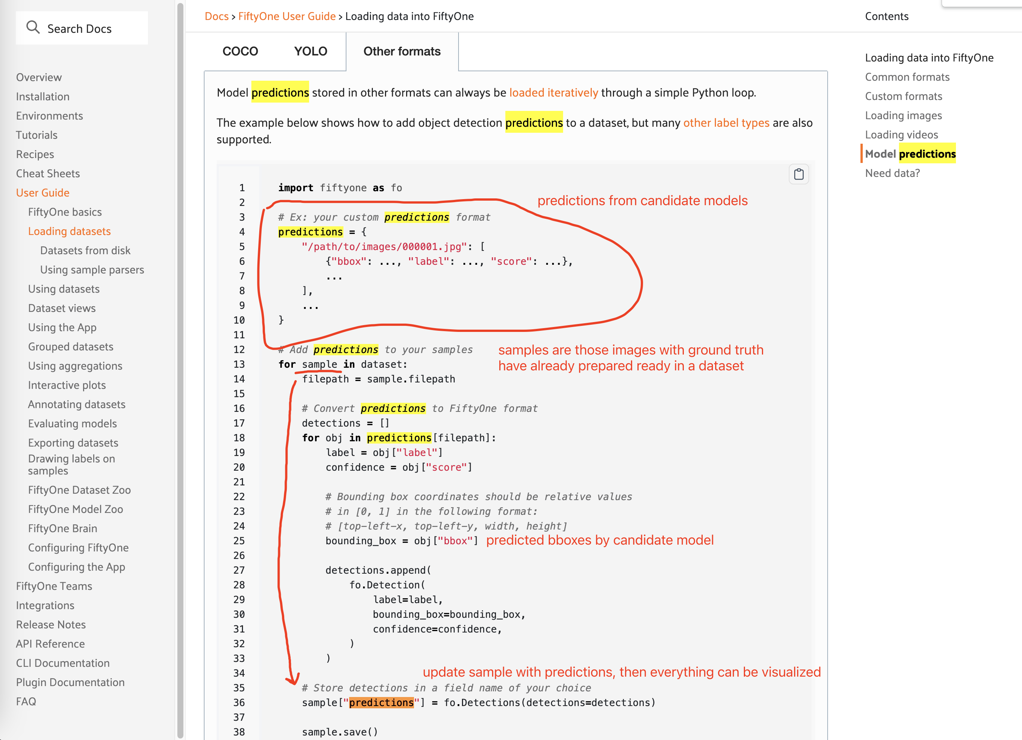
As this sample code shows, we can manage the candidate model predictions and the ground truth altogether with FiftyOne.
To the latest team discussion, there are mainly 3 parts of the job to this part:
Unify different model prediction formats and store the results into a dataset.
Maintain an application to label raw images and store ground truth in the dataset.
Develop this application to manage the model performance and visualizations.
https://docs.voxel51.com/user_guide/dataset_creation/index.html

Slide 18
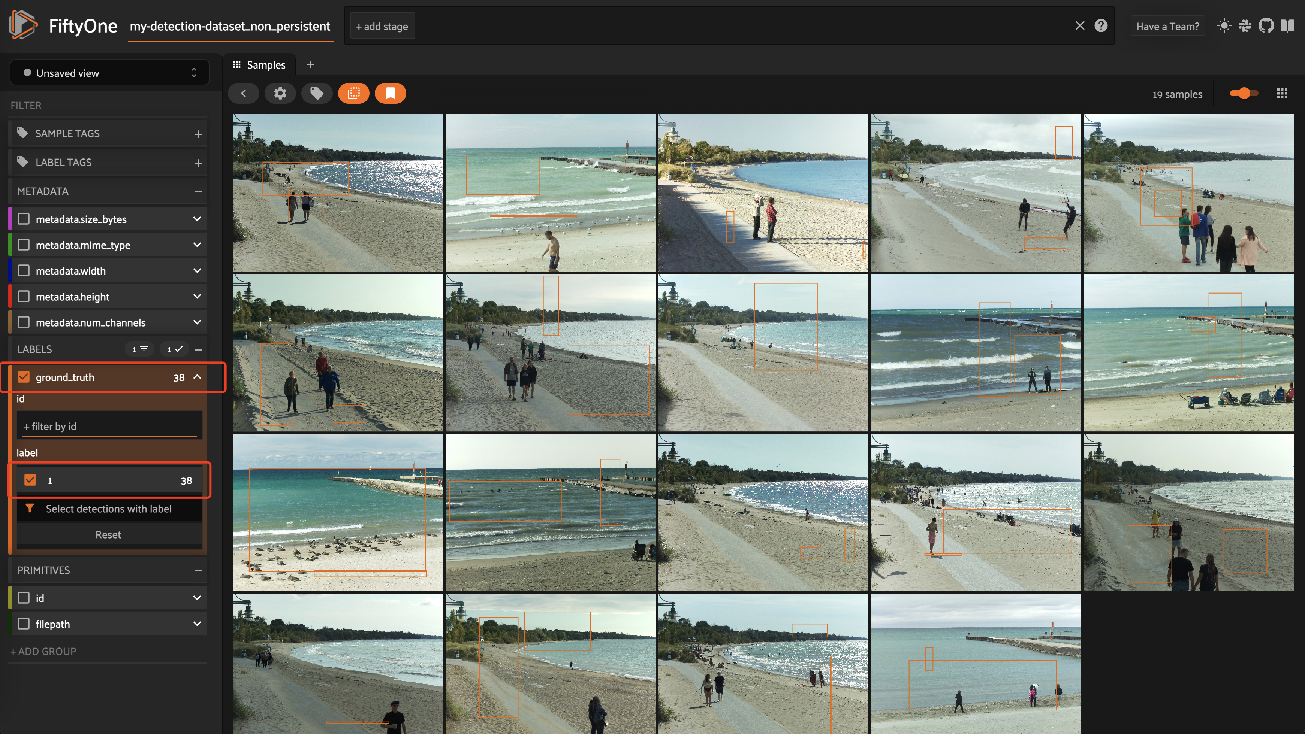

Slide 19
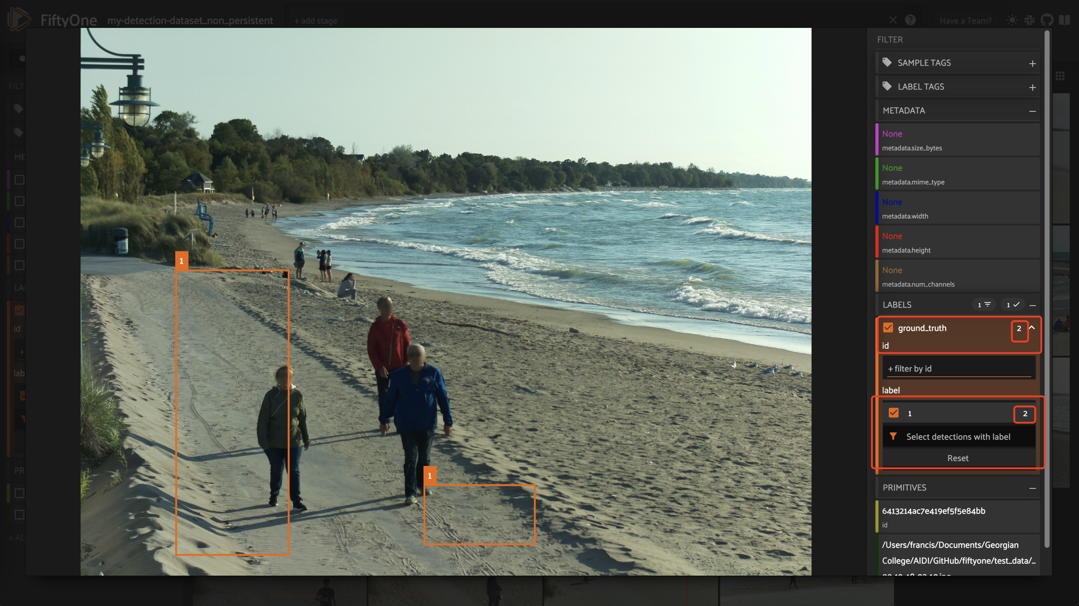

Slide 20
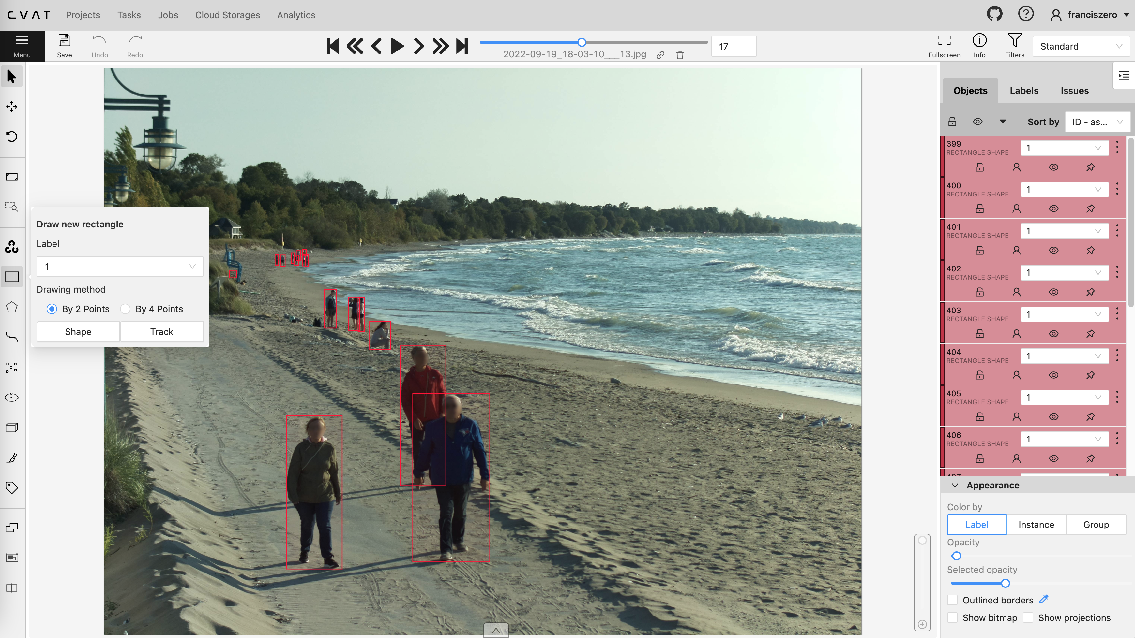
https://opencv.github.io/cvat/docs/manual/basics/create_an_annotation_task/
https://docs.voxel51.com/user_guide/dataset_creation/datasets.html#cocodetectiondataset

Slide 21
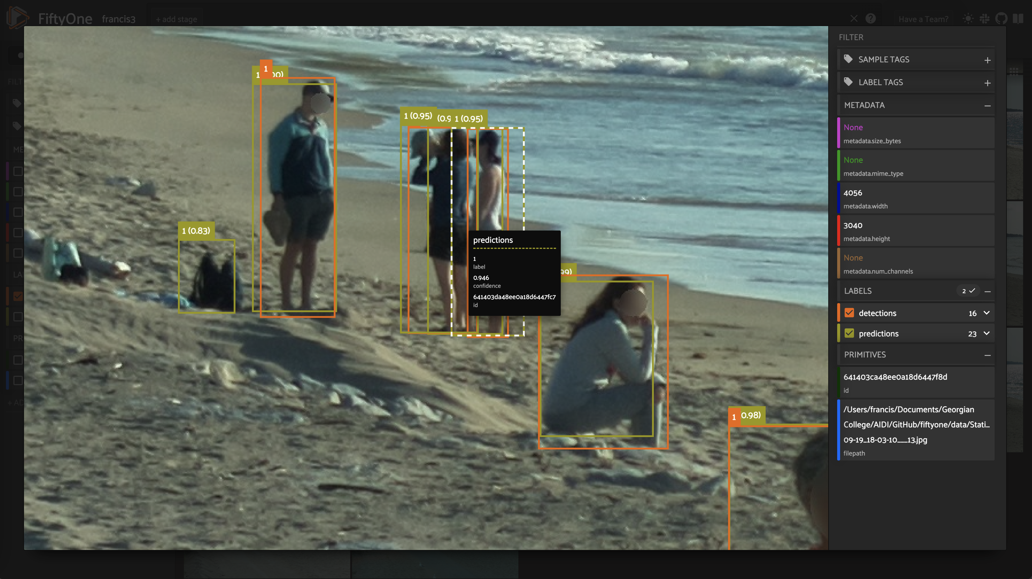
Adding model predictions: https://docs.voxel51.com/recipes/adding_detections.html

Slide 22
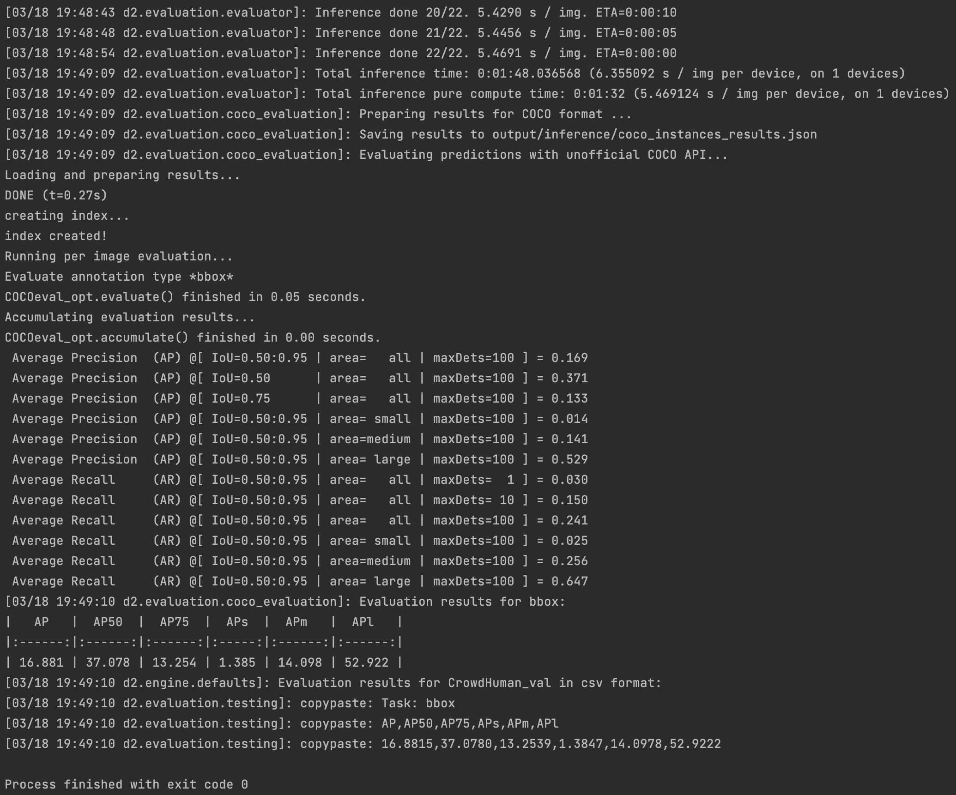
Detection Evaluation & metrics: https://cocodataset.org/?spm=a2c6h.12873639.article-detail.6.34c41d3e4kTtbZ#detection-eval
Evaluation Code & demo: https://github.com/cocodataset/cocoapi/blob/master/PythonAPI/pycocoEvalDemo.ipynb

Slide 23
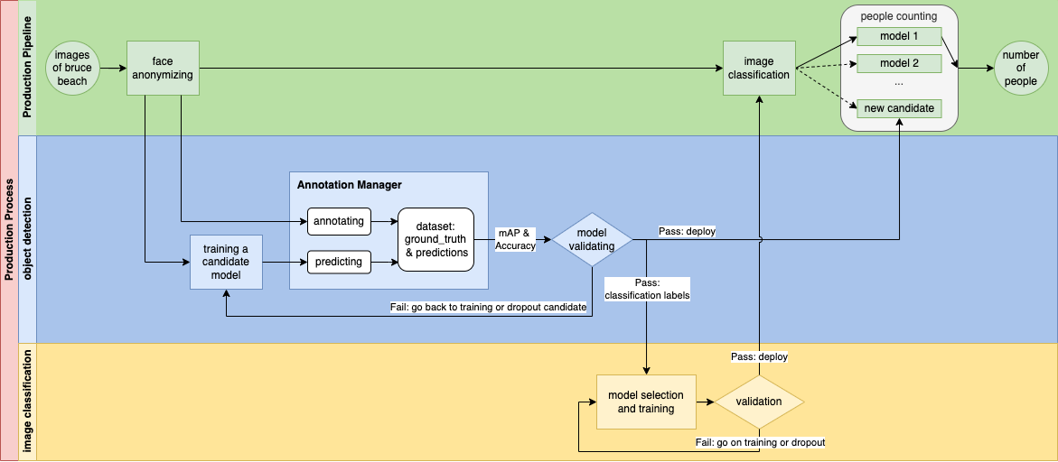

Slide 24
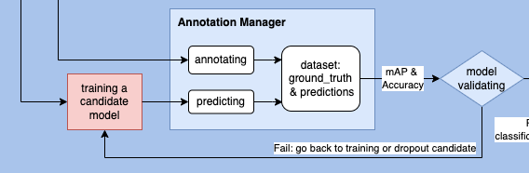
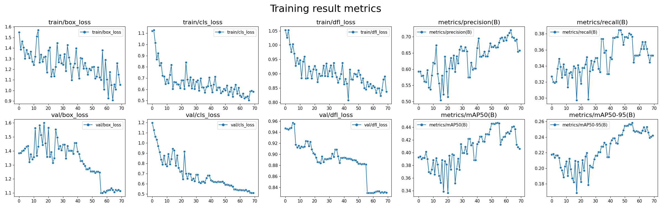

Slide 25

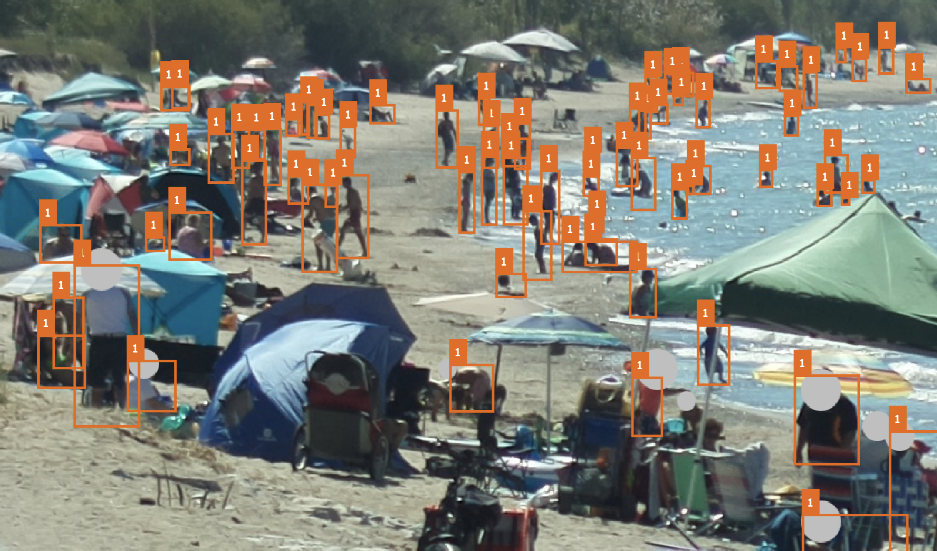
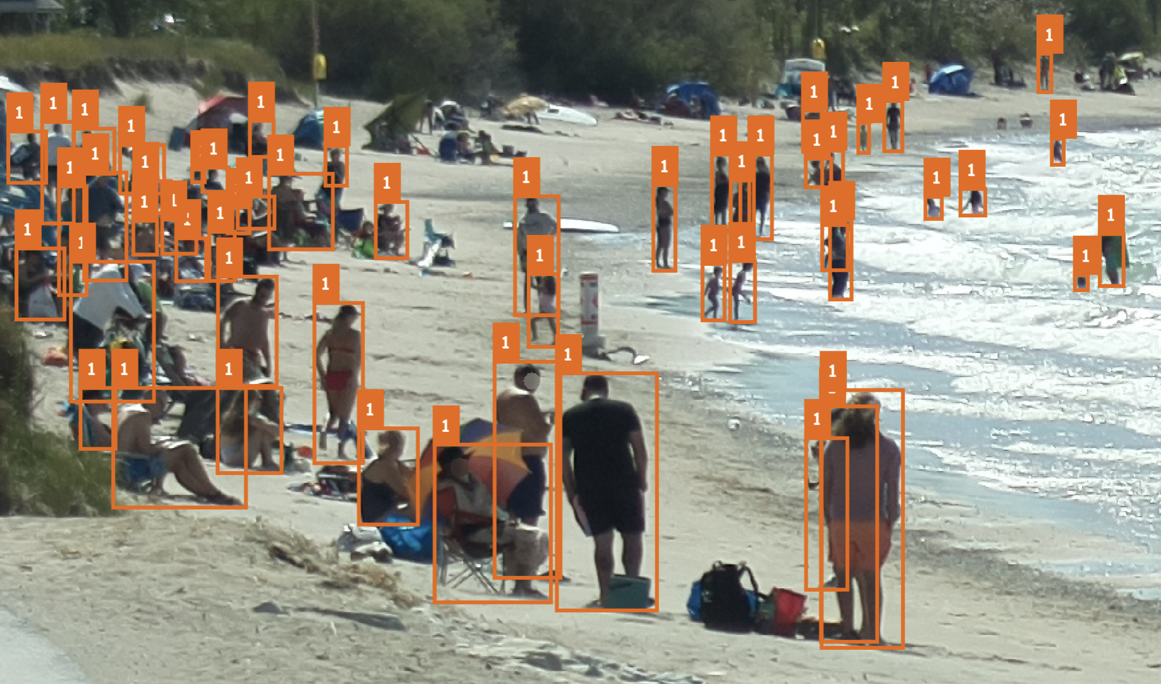
Picture3.png
2022-09-02_13-50-14.png

Slide 26
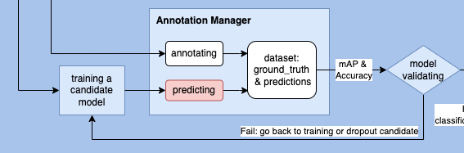
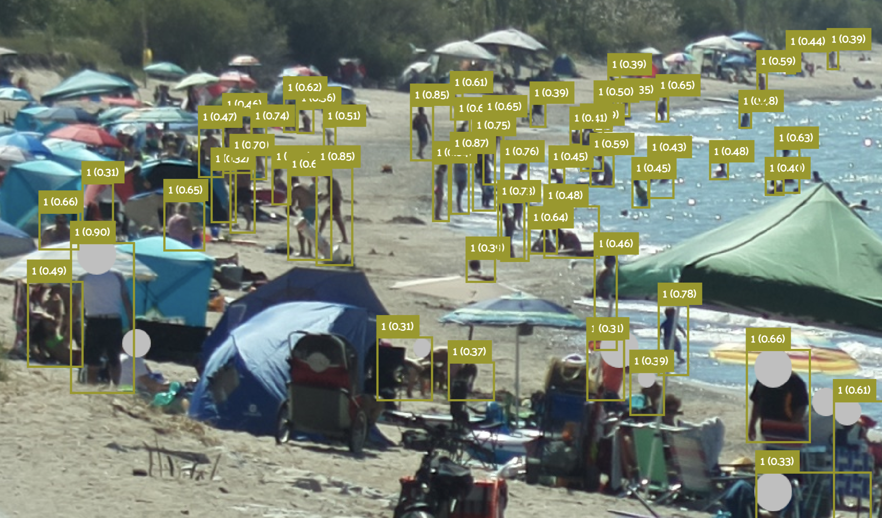
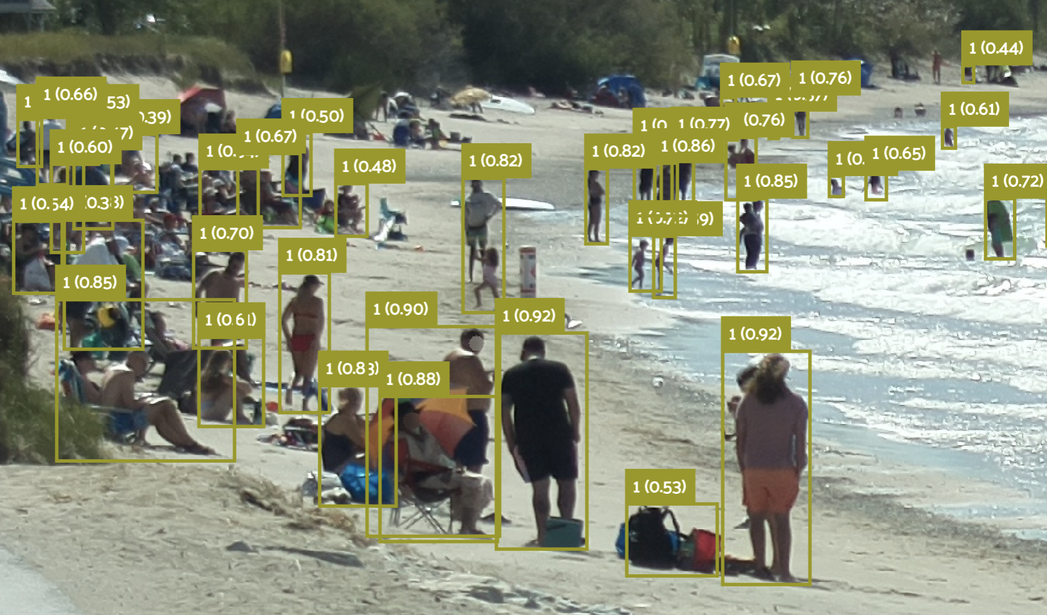
Picture3.png
2022-09-02_13-50-14.png

Slide 27
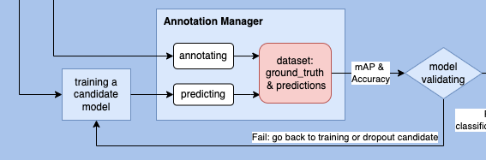
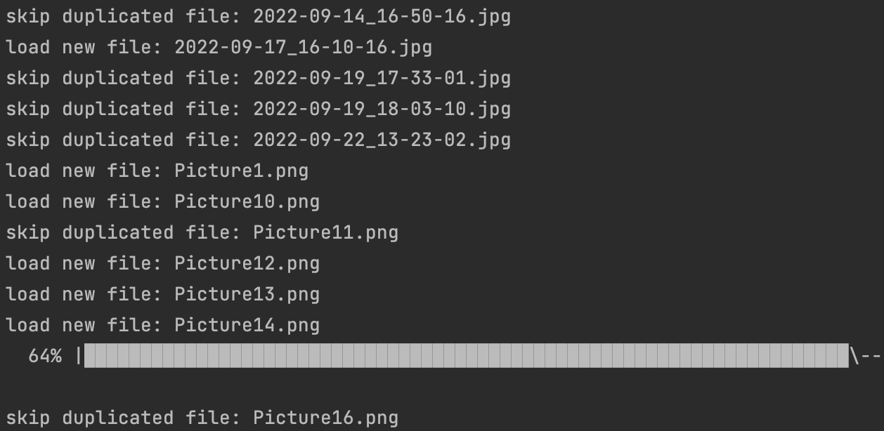
Incrementally update the ground_truth & predictions of new images

Slide 28
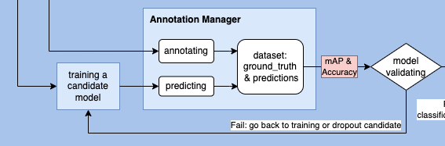
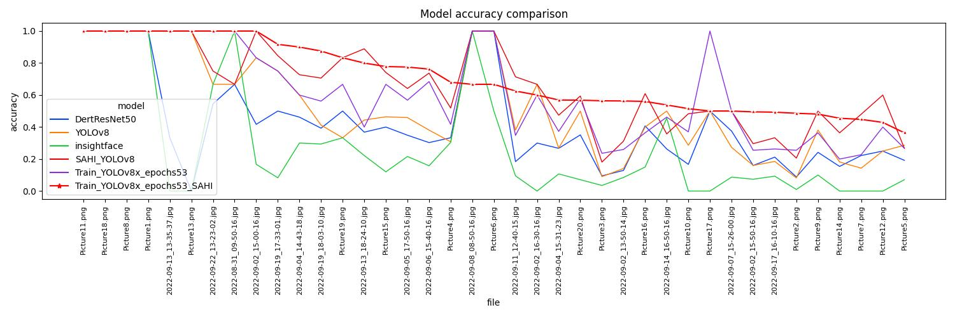

Slide 29
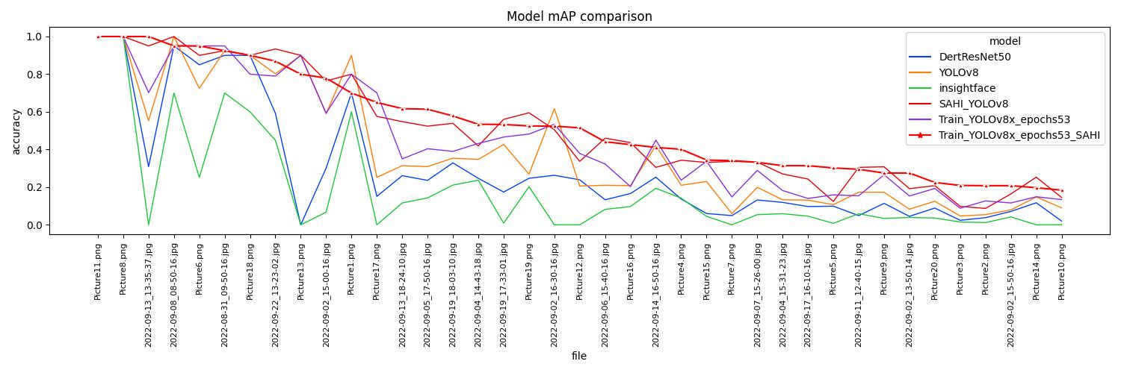

Slide 30

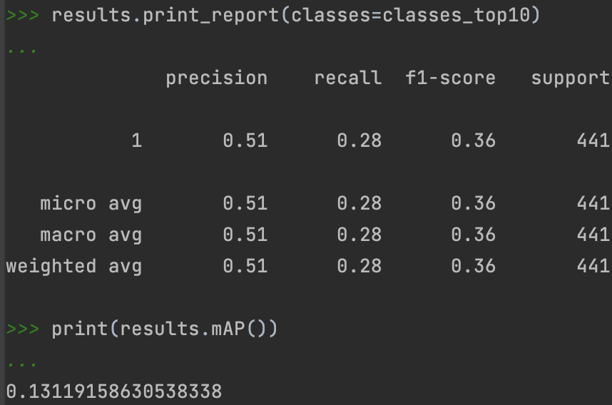
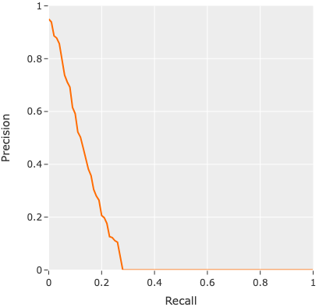

Slide 32
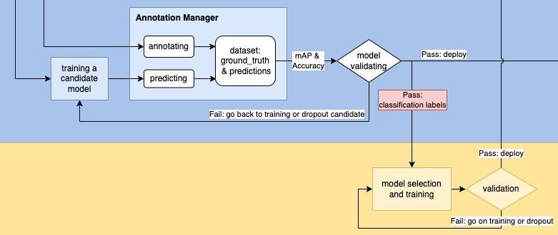
file | accuracy
2022-08-31_09-50-16.jpg | insightface
2022-09-02_13-50-14.jpg | SAHI_YOLOv8
2022-09-02_15-00-16.jpg | SAHI_YOLOv8
2022-09-02_15-50-16.jpg | SAHI_YOLOv8
2022-09-02_16-30-16.jpg | YOLOv8
... | ...

Slide 33
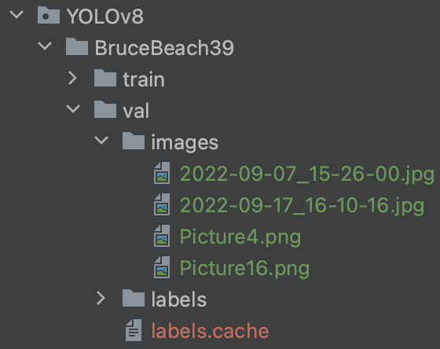
Require more training data
Only 4 images, 10% of all, can be used as validation data
More training data is required
SAHI + Training: this is the most desirable progress in this work.

Slide 34

Activities to be Completed before Next report:
Implementing classification model RCNN.
After finding the classes, we will look for the best crowd-counting model that fits each class.
Plan for now?
Crowd Counting
Notes:
Olexa, Peter (n.d.) A Person Making a Schedule. Accessed on January 18th, 2023 from https://www.pexels.com/photo/a-person-making-a-schedule-14299948/

Slide 35
Thank you!
Questions?
Notes:
Image: Leloo, The first (2022) https://www.pexels.com/photo/question-marks-on-paper-crafts-5428833/

